Slide 1

Health diagnostics for anyone, anywhere
Team HealthHack,
Ashutosh Pandey
Aman Lodha
Dayananda Sagar College of Engineering

Slide 2
Understanding The Problem
More than 50% of heart attack cases in India reach the hospital late. After 180 minutes, heart muscles begin to die. Heart attacks are often conflated with other conditions.
01
A staggering 60% of Indian ambulances don’t have basic diagnostic tools. With the traffic situation getting worse, Motorcycle ambulances are becoming popular which are even worse equipped.
02
Countries such as Britain that focus on stabilising the patient and recording vitals tend to have lower death rates for accidents (2.4%) than others. In India this figure is 16.6%.
03

Slide 3
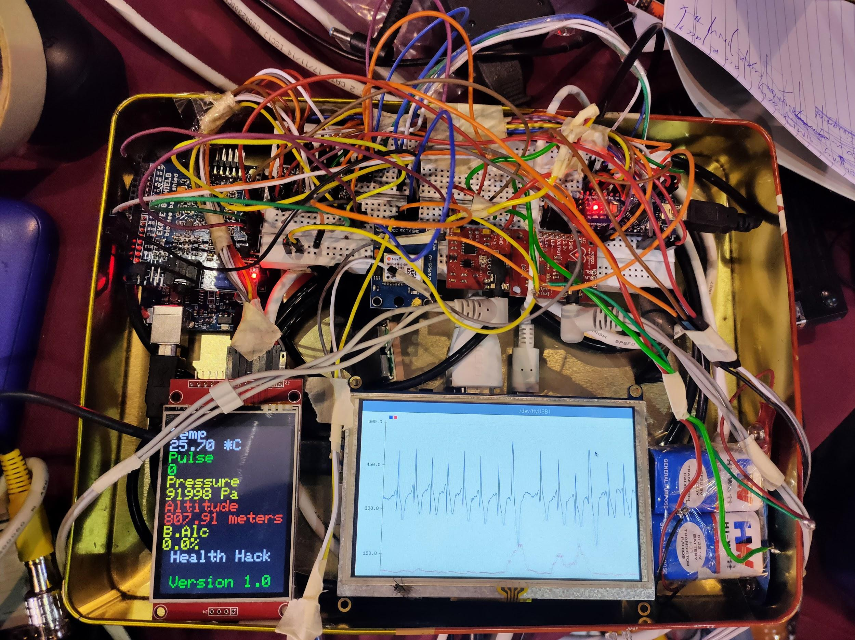
Our Product
Cost effective, portable solution to diagnostics that is modular.
We integrate an ECG (Electrocardiogram), EMG (Electromyography), Temperature, Altitude, Alcometer,Thermal Imaging sensor and GPS
The details can be seen on a display integrated into the kit, as well as the app that can be accessed by the first aid responder and doctor.

Slide 4
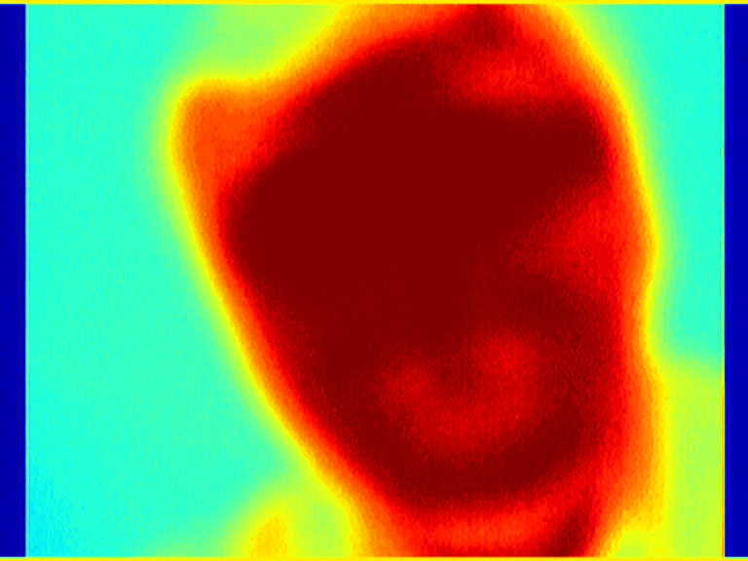
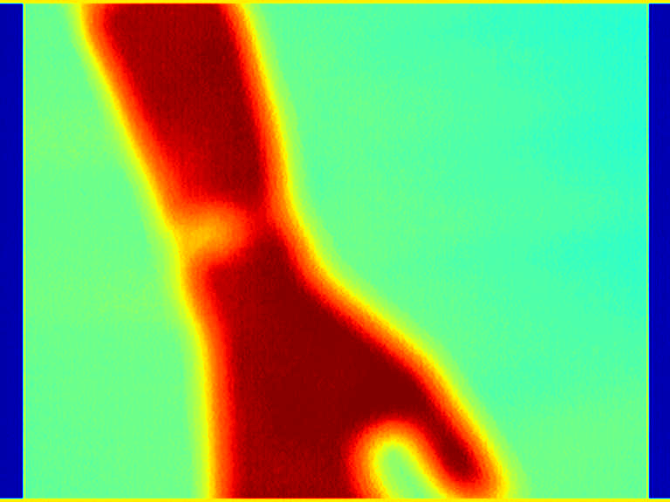
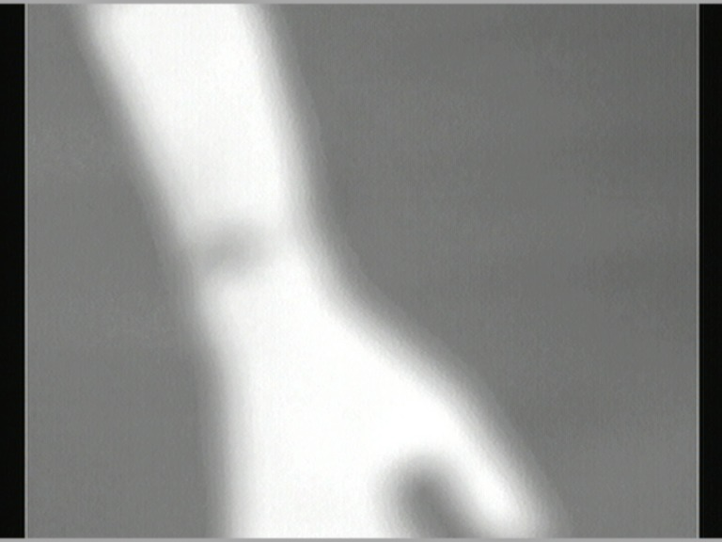
Thermal Imaging
X Ray and NMR are too expensive and power hungry to be implemented effectively in a portable setting. Thermal imaging is normally used for security surveillance and produces greyscale images. Using Image processing we were able to get a color map which can indicate conditions like concussions and internal bleeding.

Slide 5
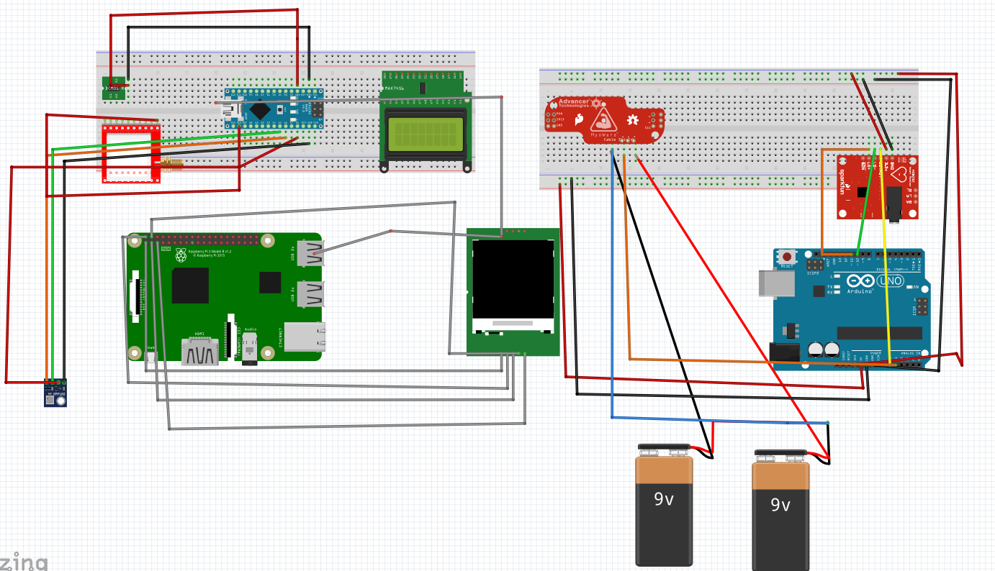

Slide 6
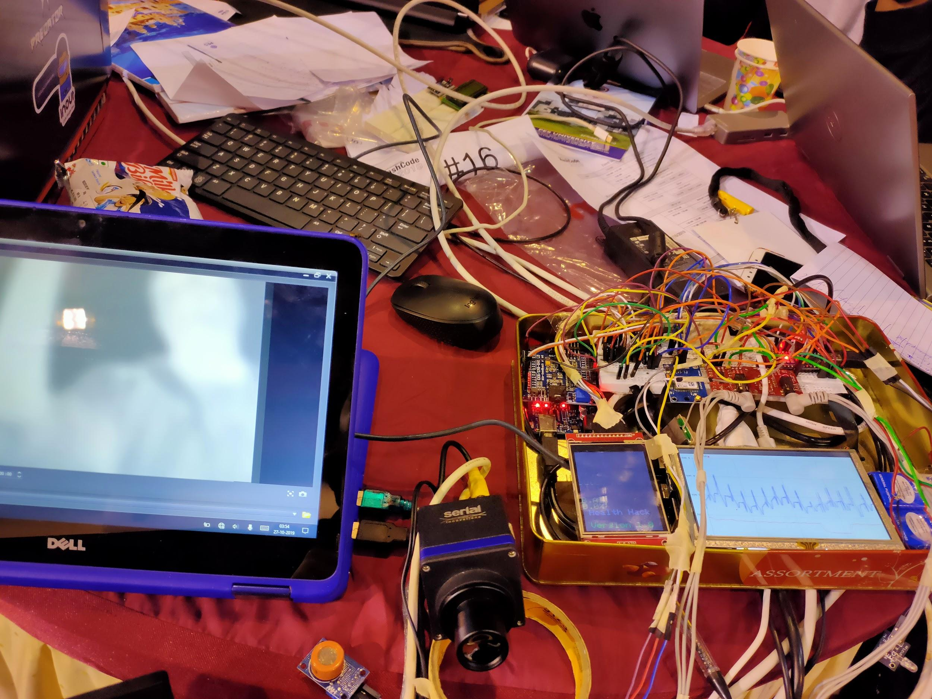
Hardware Assembly

Slide 7
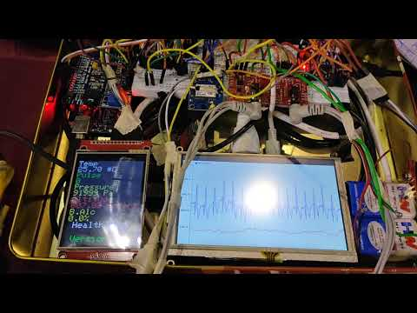
Hardware

Slide 8
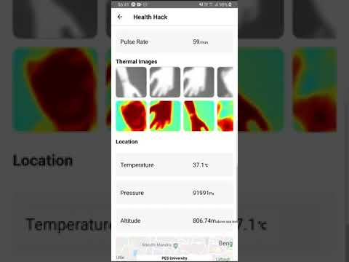
APP

Slide 9
Future Scope
Using Machine learning models developed for dual channel ECG to detect Heart Arrhythmia.
Using thermal image processing to detect under skin injuries such as concussions.
Fabricating a single PCB with all the sensors embedded to make the unit more compact.
App offering long term patient data logged over weeks and months, with analytics.

Slide 10








Our tech stack

